Slide 1

“Your Project Name”
Task - 2
“E-COMMERCE WEBSITE”
Task - 2

Slide 2

E-Commerce Search and Filtering System
E-commerce (electronic commerce) is the buying and selling of goods and services, or the transmitting of funds or data, over an electronic network, primarily the internet.
LMS Username
Name
Batch
au112720205004
JOTHI. P
1
au112720205501
BOWSHIYA. S
1
au112720205006
PRIYADHARSHINI. K
1
au112720205007
SRINIVAS. M.B
1

Slide 3

Taskꢀ-ꢀ2
CreateꢀUIꢀandꢀimplementꢀvariousꢀcomponentsꢀusingꢀreact
●
●
●
SplitꢀdesignꢀintoꢀcomponentsꢀandꢀHigherꢀorderꢀComponents
Defineꢀstructureꢀofꢀtheꢀcomponents
Setꢀtheꢀbasicꢀuiꢀcomponentsꢀwithꢀdummyꢀdata
IntegrateꢀtheꢀAPIsꢀtoꢀfrontendꢀtoꢀensureꢀtheꢀdynamicꢀfeatureꢀofꢀwebsite
●
●
●
●
●
Pointꢀbaseꢀapiꢀtoꢀtheꢀseversꢀbaseꢀurlꢀ
Designꢀapiꢀcallsꢀforꢀeachꢀelementꢀ
Handleꢀerrorsꢀinꢀtheꢀoutput
Renderꢀoutputꢀofꢀapisꢀtoꢀdifferentꢀlowꢀlevelꢀcomponents
Secureꢀcontentꢀofꢀpostꢀapisx
EvaluationꢀMetric:
● 100%ꢀCompletionꢀofꢀtheꢀaboveꢀtasks
Learning Outcome
▪
▪
▪
▪
DevelopingꢀcomplicatedꢀUIꢀusingꢀreactꢀcomponents
Usingꢀpropsꢀdrillingꢀandꢀcontextꢀtoꢀpassꢀvariables
Gettingꢀfamiliarꢀwithꢀdifferentꢀtypeꢀofꢀapiꢀcalls
Handlingꢀdifferentꢀinputꢀdata

Slide 4

Step-WiseꢀDescription
Setup React Project
Create Component Structure
Create Base Components
Higher Order Components (HOCs)
Define Component Structure
Set Up Routing
Implement UI Components
Dummy Data Integration
Test and Debug
Refine and Optimize
Documentation
Version Control

Slide 5
Summary of the Task
The task involves setting up a React project by creating a well defined component structure, including base components and Higher Order Components (HOCs). It requires defining the overall component structure, implementing routing, designing UI components, integrating dummy data, testing and debugging the application, refining and optimizing the code, and documenting the project. Additionally, version control is essential to manage changes effectively throughout the development process.

Slide 6
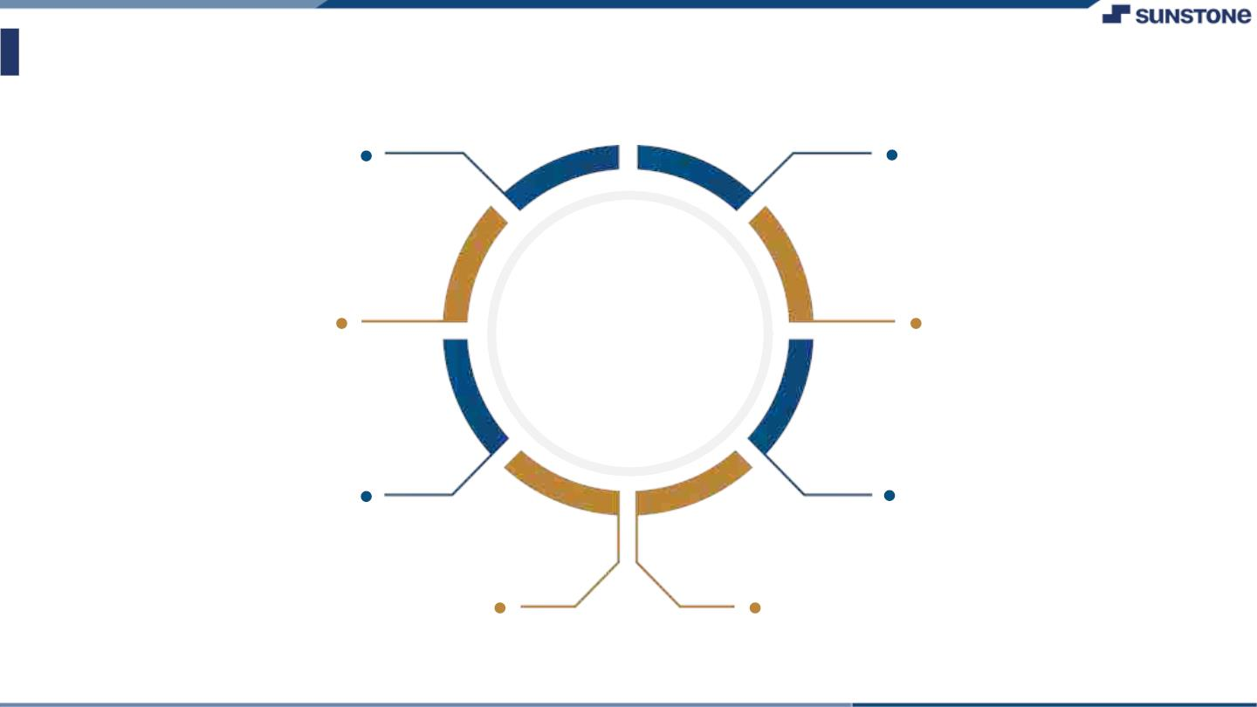
AssessmentꢀParameter
SetupꢀProjectꢀforꢀCalculatorꢀ
project
Setupꢀbasicꢀstructureꢀofꢀtext-
editorꢀproject
Createꢀaꢀmainꢀcomponentꢀwithꢀtheꢀ
outerꢀstructureꢀofꢀcalculator
Check-List
Createꢀmainꢀcomponentꢀwithꢀ
allꢀfeatureꢀbuttons
Createꢀaꢀbuttonꢀcomponentꢀ
withꢀonꢀclickꢀhandler
Createꢀaꢀjsonꢀobjectꢀtoꢀstoreꢀ
dataꢀforꢀtextꢀeditor
Createꢀaꢀ`ꢀevaluateExpresion`ꢀ
functionꢀtoꢀevaluateꢀvalue
Pushꢀbothꢀcodeꢀtoꢀgithub

Slide 7

Submission Github
https://github.com/Srinivas5007/NM-SPCET-IT-GROUP1.git

Slide 8


